Slide 1
Flask and FastAPI Basics
Week 5 - Day 2

Slide 2
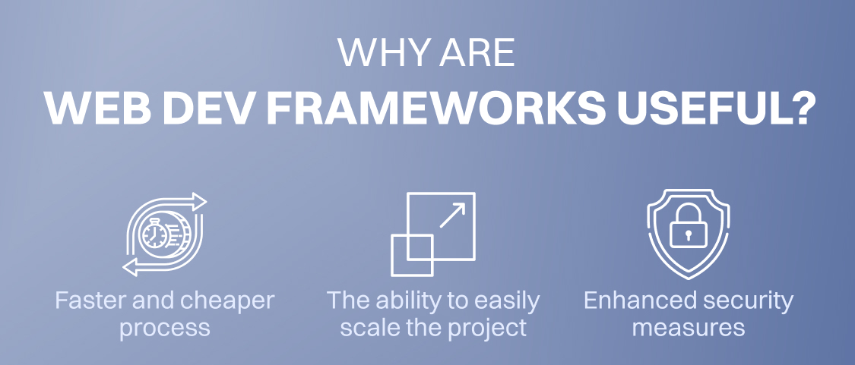



What is a Web Development Framework?
A web development framework is a software framework designed to support the development of web applications, simplifying the process by providing tools and libraries. It handles routing, request processing, and server interactions, reducing boilerplate code and enabling rapid API and service development. These frameworks offer structured approaches to web service creation, crucial for modern application development.
Simplified Development
Handles Routing
Server Interaction
Frameworks streamline the web service creation process.
Manages request routing efficiently.
Facilitates server communication.

Slide 3
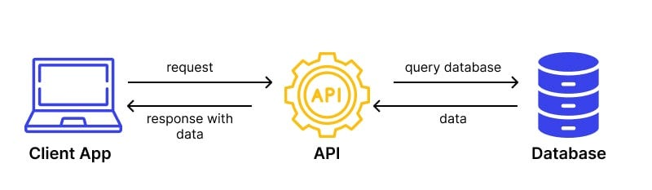
What is a Web Development Framework?

Slide 4
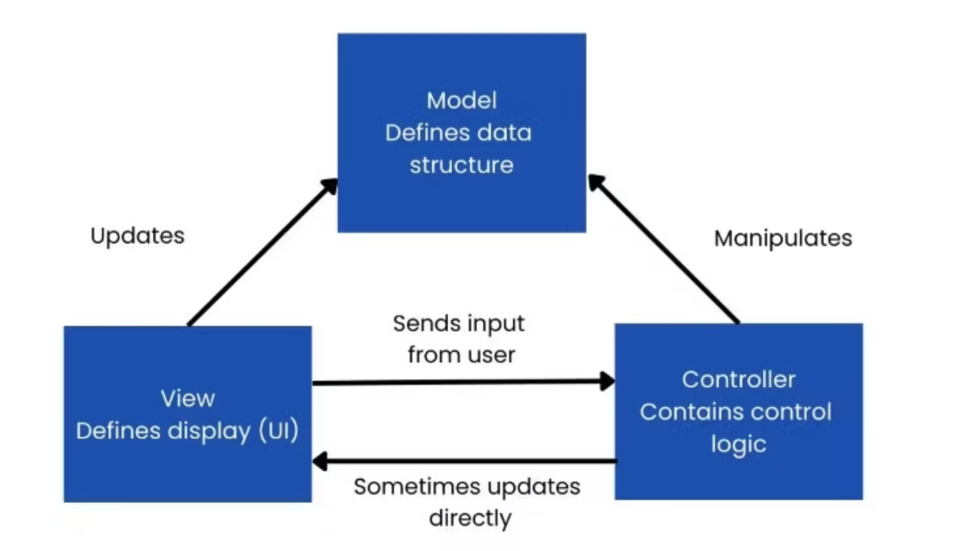
Introduction to Flask
Flask, a micro web framework released in 2010, is a lightweight and flexible Python framework built on WSGI (Web Server Gateway Interface). Its simplicity and modular design make it ideal for small to medium-sized applications, allowing developers to pick components they need. The extensive ecosystem of extensions further enhances its capabilities, making it a versatile choice.

Slide 5

Flask Features
Provides development server and debugger.
Light framework.
Uses Jinja2 templates.
Has extensions that help enhance its functionalities.
Integrated support for unit testing.
Neat API.
Lightweight
Flexible
Extensible
Minimal core with extension capabilities.
Allows developers to choose components.
Vast ecosystem of third-party extensions.
Simple Routing
Dev Server
Jinja2
Easy URL mapping to functions.
Quick setup for local development.
Powerful templating engine.

Slide 6
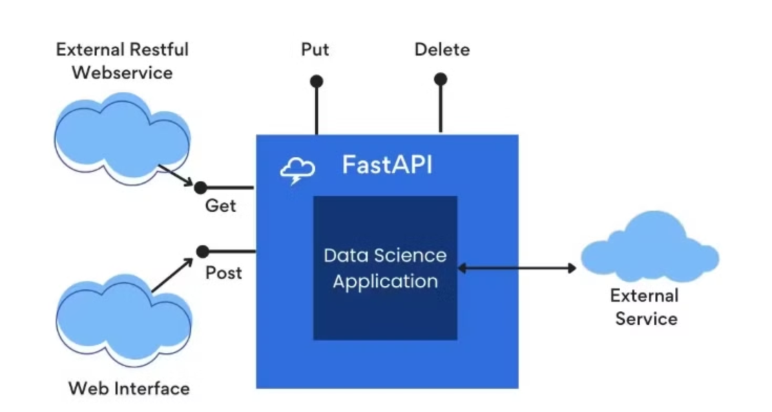
Introduction to FastAPI
FastAPI, a modern web framework released in 2018, is built on ASGI (Asynchronous Server Gateway Interface) and designed for high-performance APIs. Its native support for async/await programming enables developers to write concurrent code, improving application responsiveness. Moreover, the automatic API documentation with Swagger UI enhances usability.

Slide 7
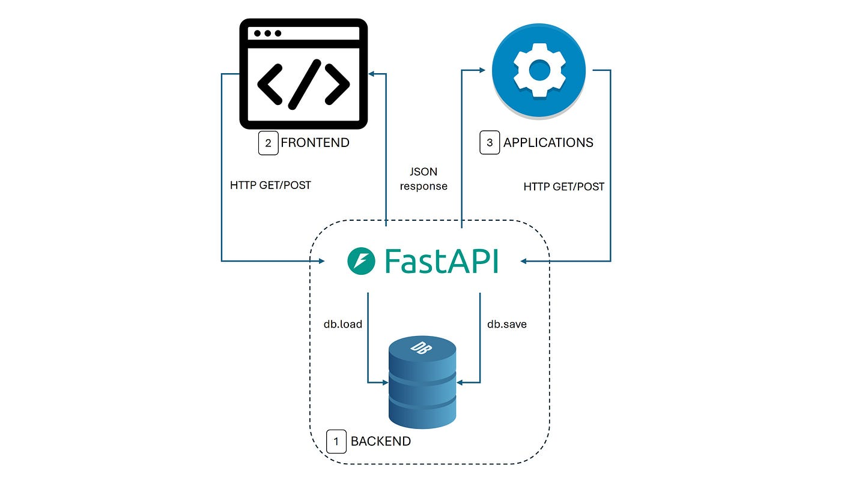

Slide 8
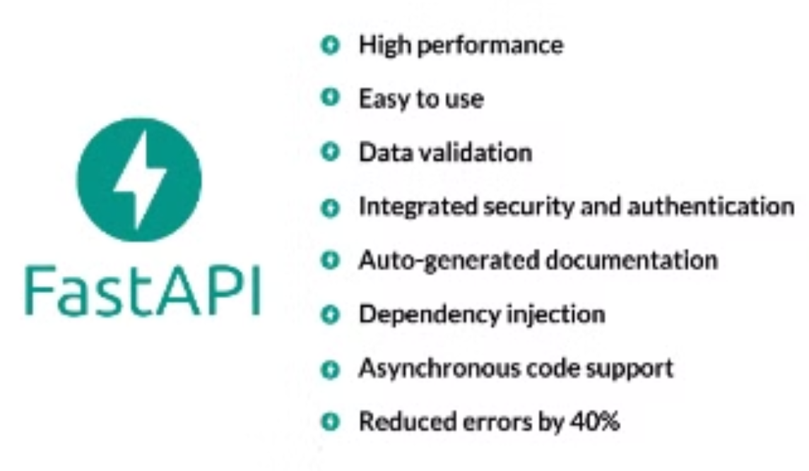
FastAPI Features
FastAPI provides automatic data validation with Pydantic, ensuring data integrity, and bAppuilt-in Swagger UI for interactive API documentation. It utilizes type hints and input validation, reducing common errors. Known for high performance comparable to Go and Node.js, it supports dependency injection, making it ideal for machine learning and data science APIs.

Slide 9
Performance Comparison
FastAPI exhibits significantly faster performance than Flask due to its async support, which enables concurrent request handling. Unlike Flask, which processes requests synchronously, FastAPI can handle 2-3x more concurrent connections while consuming fewer resources for high-traffic applications. This makes it a superior choice for performance-critical applications.
Concurrency
Limited
High
Speed
Moderate
Fast
Resource Use
Higher
Lower

Slide 10


Deployment of Machine Learning Models
Both Flask and FastAPI support the deployment of machine learning models, but they offer different approaches. Flask employs a traditional method with extensions, while FastAPI adopts a modern, type-safe approach. Consider performance, model complexity, and scalability needs when choosing. FastAPI's asynchronous capabilities make it an attractive option for complex, high-performance models.
Flask
Traditional extensions
FastAPI
Modern, type-safe

Slide 11
When to Use Flask vs. FastAPI
Flask is suitable for simple web applications, smaller projects, and when leveraging its established ecosystem is crucial. FastAPI shines in high-performance APIs, microservices, real-time applications, and machine learning model deployment, offering efficiency and speed for complex tasks.
Flask
FastAPI
Simple Apps
High-Performance APIs
Small Projects
Microservices
Ecosystem
ML Deployment

Slide 12



Conclusion: Choosing the Right Framework
There is no one-size-fits-all solution when selecting a web framework. Carefully evaluate project requirements, considering performance, complexity, and future scalability. Both Flask and FastAPI are powerful tools for ML model deployment, each with unique strengths. Understanding these strengths allows developers to make informed decisions aligned with specific project goals.
Consider Scale
2
Evaluate Needs
1
3
Choose Wisely

